Slide 1
THE WAR ON GENERIC, REPURPOSED MEDICINES IN COVID-19:
THE TOGETHER TRIAL
Pierre Kory, MPA, MD
President, Chief Medical Officer
Front Line COVID-19 Critical Care Alliance

Slide 2
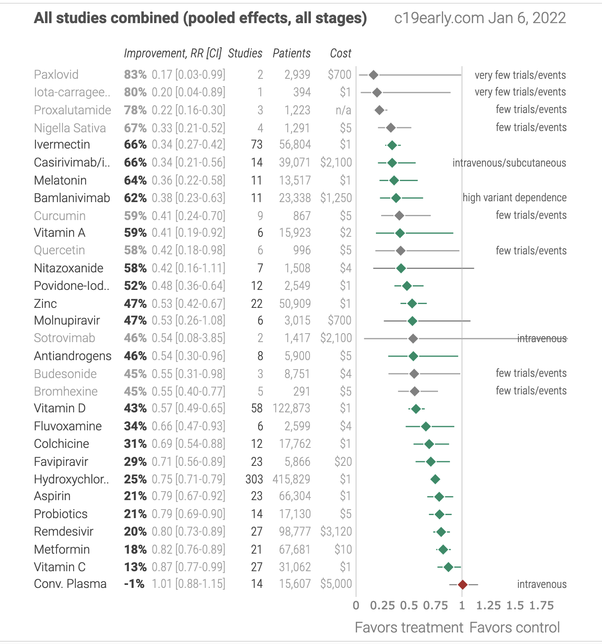
DESPITE OVER TWO DOZEN REPURPOSED MEDICATIONS WITH CLINICAL TRIALS SHOWING EFFICACY IN COVID, NONE ARE RECOMMENDED IN THE U.S.

Slide 3
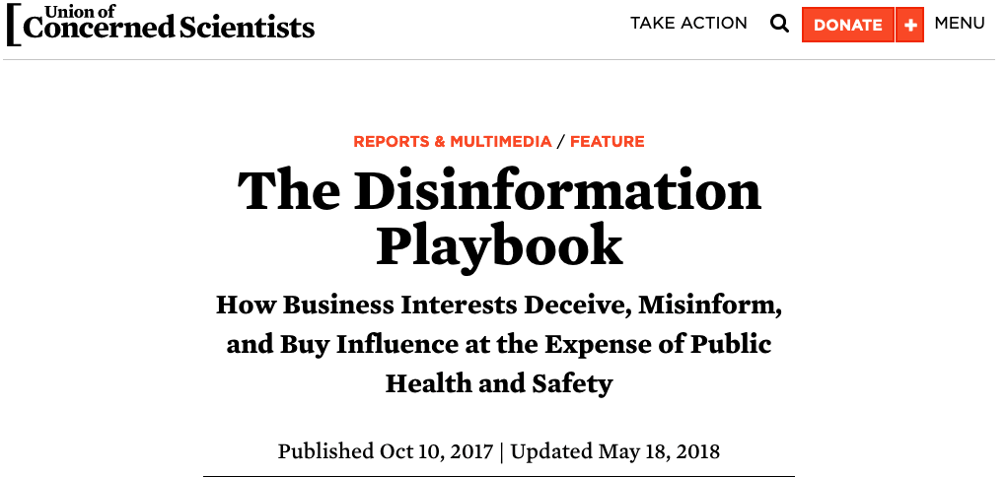
CORPORATE TACTICS TO COUNTER “SCIENCE INCONVENIENT TO THEIR INTERESTS”
A "Disinformation Playbook" has been used for decades by corporations to delay government action on matters that would adversely affect their income and profit.
1. The Fake - Conduct counterfeit science and try to pass it off as legitimate research
2. The Blitz - Harass scientists who speak out with results or views inconvenient for industry.
3. The Diversion - Manufacture uncertainty about science where little or none exists.
4. The Screen - Buy credibility through alliances with academia or professional societies.
5. The Fix - Manipulate government officials or processes to influence policy inappropriately.

Slide 4
PHARMACEUTICAL COMPANY “DISINFORMATION” TACTICS
“The Diversion” - Manufacture counterfeit science
  selectively publishing negative results while underreporting positive results
  commission scientific studies with flawed methodologies biased toward predetermined results
  planting ghostwritten articles in legitimate scientific journals
  These methods undermine the scientific process and can have serious public health and safety consequences

Slide 5

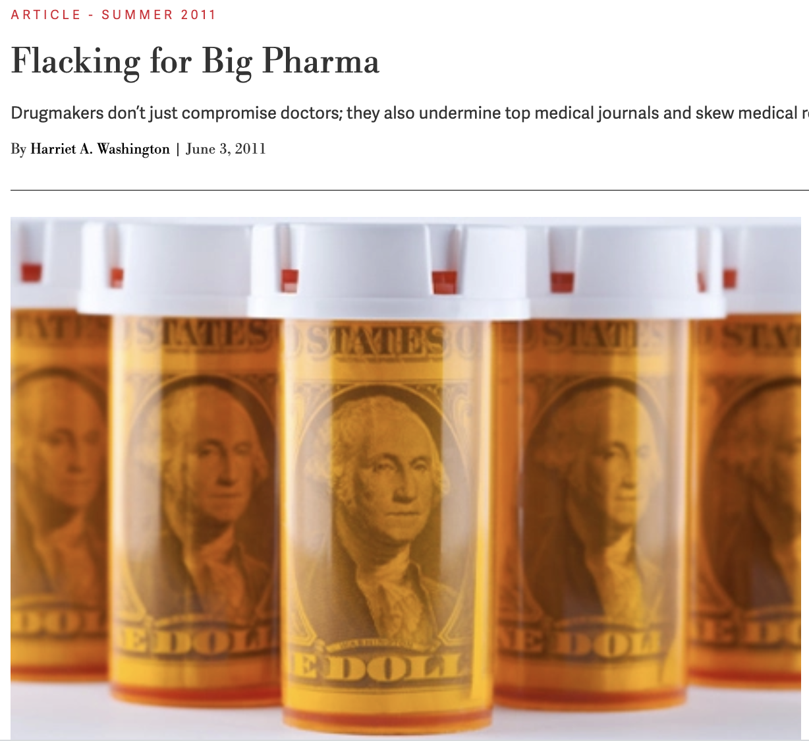

Slide 6

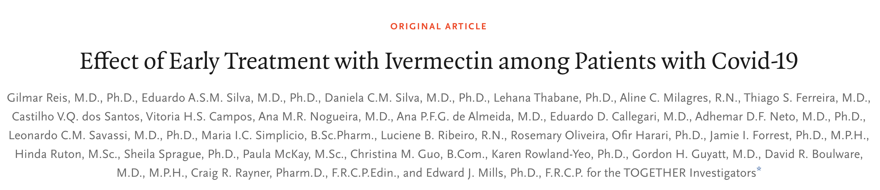
THE TOGETHER TRIAL – MARCH 30, 2022

Slide 7
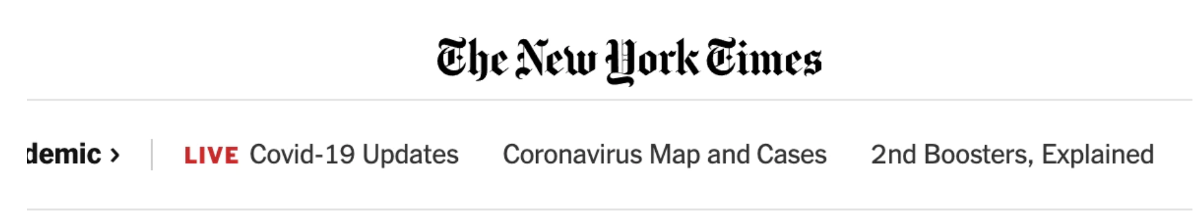
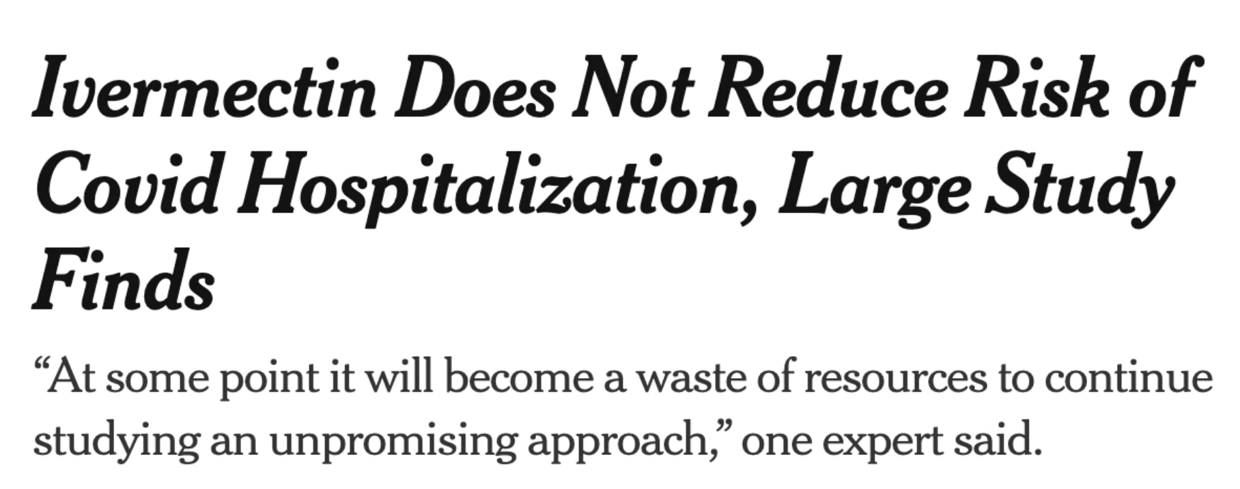

Slide 8
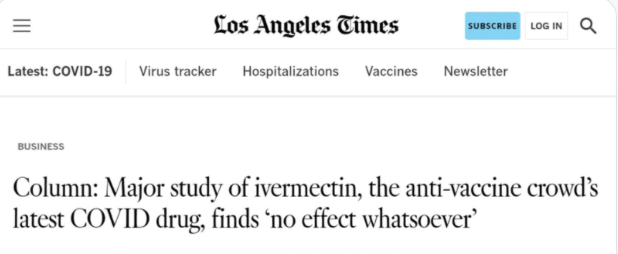
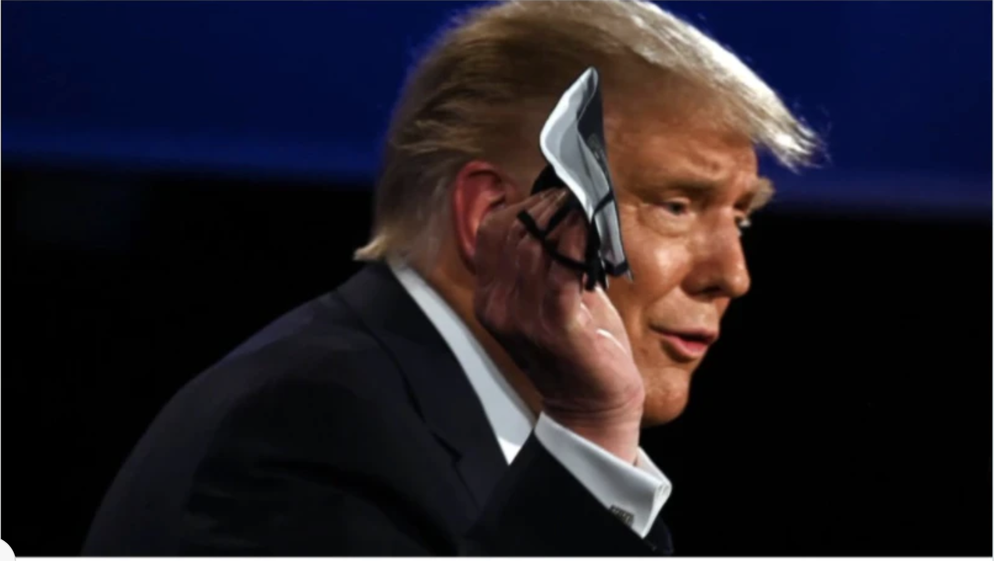

Slide 9
CONFLICTS OF INTEREST UP THE WAZOO (that the FLCCC doesn’t have)
Possibly the largest financial conflict of interest of any trial to date. Disclosed conflicts of interest include: Pfizer, Merck, Bill & Melinda Gates Foundation, Australian Government, Rainwater Charitable Foundation, Fast Grants, Medicines Development for Global Health, Novaquest, Regeneron, Astrazeneca, Daichi Sankyo, Commonwealth Science and Research Organization, and Card Research. Many conflicts of interest appear unreported. For example, Unitaid is a sponsor [Harper, togethertrial.com].
Analysis done by a company that receives payment from and works closely with Pfizer. All analyses were done by Cytel. Cytel is a statistical modelling company that helps pharmaceutical companies get approval — they work very closely with Pfizer Cytel's software and services are used by the top 30 pharmaceutical companies
A co-principal investigator works for Cytel and the Gates Foundation: "The majority of the time I work for a company called Cytel, where I design clinical trials, predominantly for the Bill & Melinda Gates Foundation."
The Gates Foundation is a founding partner of GAVI, which took out Google ads telling people not to use ivermectin and a major funder of Unitaid, which may have modified the results of the Hill meta analysis in a way that prevented adoption
Associated with MMS Holdings. The trial is associated with MMS Holdings whose mission includes helping pharmaceutical companies get approval and designing scientific studies that help them get approval. One of their clients is Pfizer
Certara. One of the senior investigators was Dr. Craig Rayner, President of Integrated Drug Development at Certara - another company with a similar mission to MMS Holdings. They state on their website that: "Since 2014, our customers have received over 90% of new drug and biologic approvals by the FDA." One of their clients is Pfizer

Slide 10
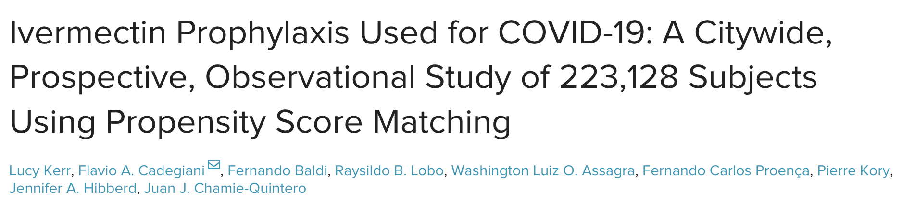
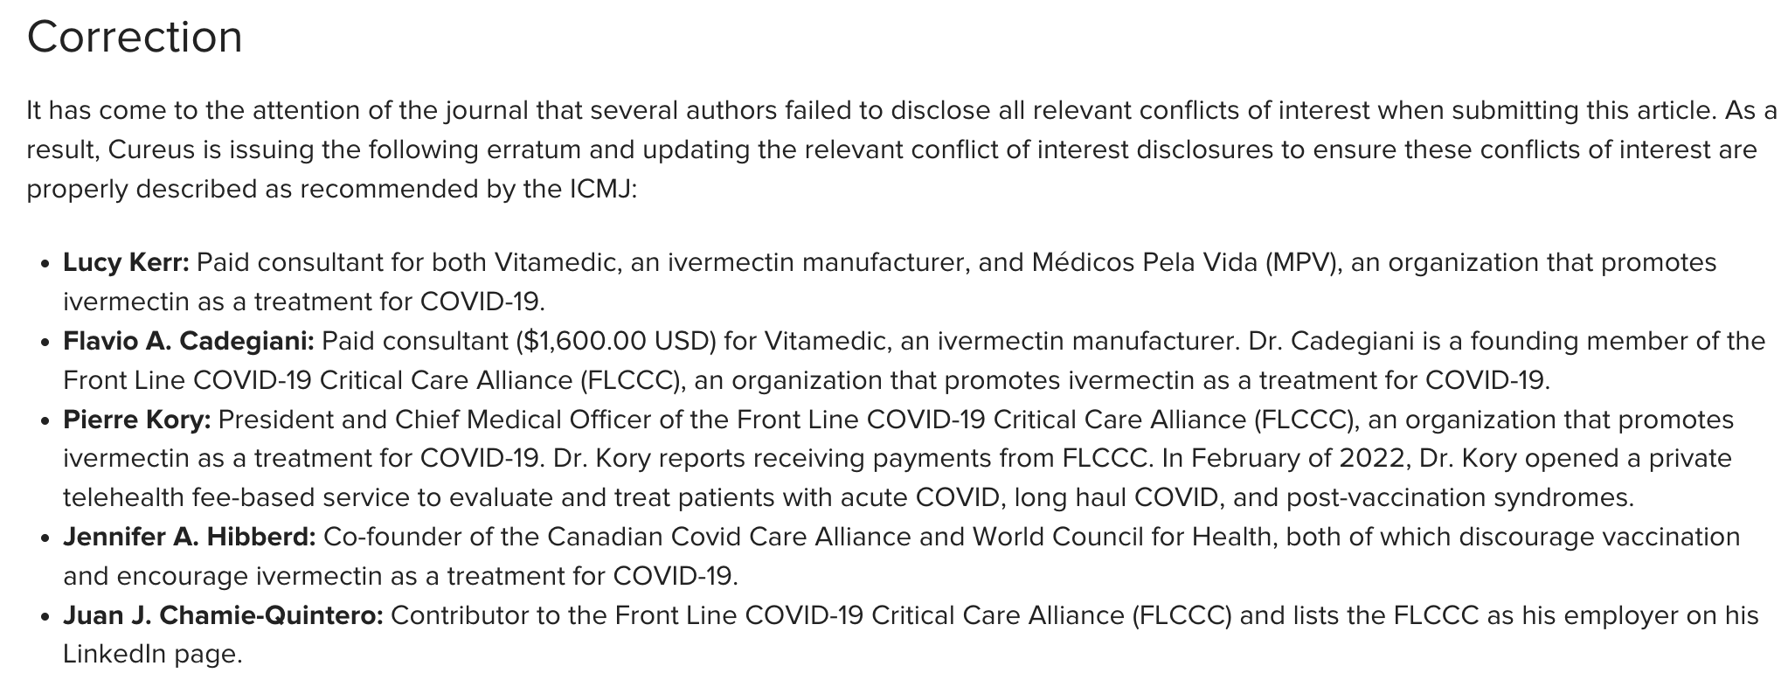

Slide 11
THE CAMPAIGN AGAINST GENERIC MEDICINES
IS A WAR OF INFORMATION
Media attacks on researchers… like me ☺
Health agencies sending bulletins recommending against use to all U.S. doctors
Media censorship of any mentions of efficacy (YouTube, Twitter, LinkedIn, FB, etc.
Positive studies of ivermectin and hydroxychloroquine retracted
Financial influence “capture” of high-level researchers (Dr. Andrew Hill)
Only “negative studies” are published in high impact journals
  WHO meta-analysis dismisses the majority of the evidence base – FRAUDULENT
  2 meta-analyses later published in “high-impact” medical journals – ALSO FRAUDULENT
  All major meta-analyses conclude there is “insufficient evidence” to recommend
Prolonged avoidance of funding of research into ivermectin – ACTIV 6??
  Then agencies fund clinical trials “designed to fail” (almost all investigators tied to Pharma)

Slide 12
“THE DIVERSION” IS THE MOST IMPACTFUL TACTIC OF THE DISINFROMATION PLAYBOOK
Definition: “manufacturing uncertainty where little or none exists”
Pharma/BMGF fund LARGE randomized studies of generic medicines “designed to fail” (studies with flawed methodologies) is guaranteed publication in a “high impact medical journal”
  Only ”high impact medical journal” studies are publicized by “major media,” articles of which echo across the world
  These articles influence doctors, scientists, journalists, and laypeople across the world
  The diversion is the single most powerful tactic to influence policy

Slide 13
The Four “High Impact” RCTs of Ivermectin
March 2021. Lopez-Medina, JAMA: ivermectin treated patients recovered in 10 days vs. 12 days in controls (not statistically significant)
July 2021. Vallejos et al. BMC Infectious Disease: 5.6% of ivm treated patients went to hospital vs. 8.4% of controls (not statistically significant)
February 2022. Loon Lim et al. JAMA. Although ivermectin treated patients ended up needing “oxygen supplementation?” more often (21.6% vs. 17.3%, they needed less mechanical ventilation (1.7% vs. 4.0%, p=.17), icu admission (2.4% vs. 3.2%) and death (1.2% vs. 4.0%, p=.09 - this latter difference is striking).
March 2022. Ries et al. NEJM. Found that ivermectin treated patients went to the ER for > 6 hours or were hospitalized less than controls (14.7% vs. 16.3%) and died less than controls (18% reduction).

Slide 14
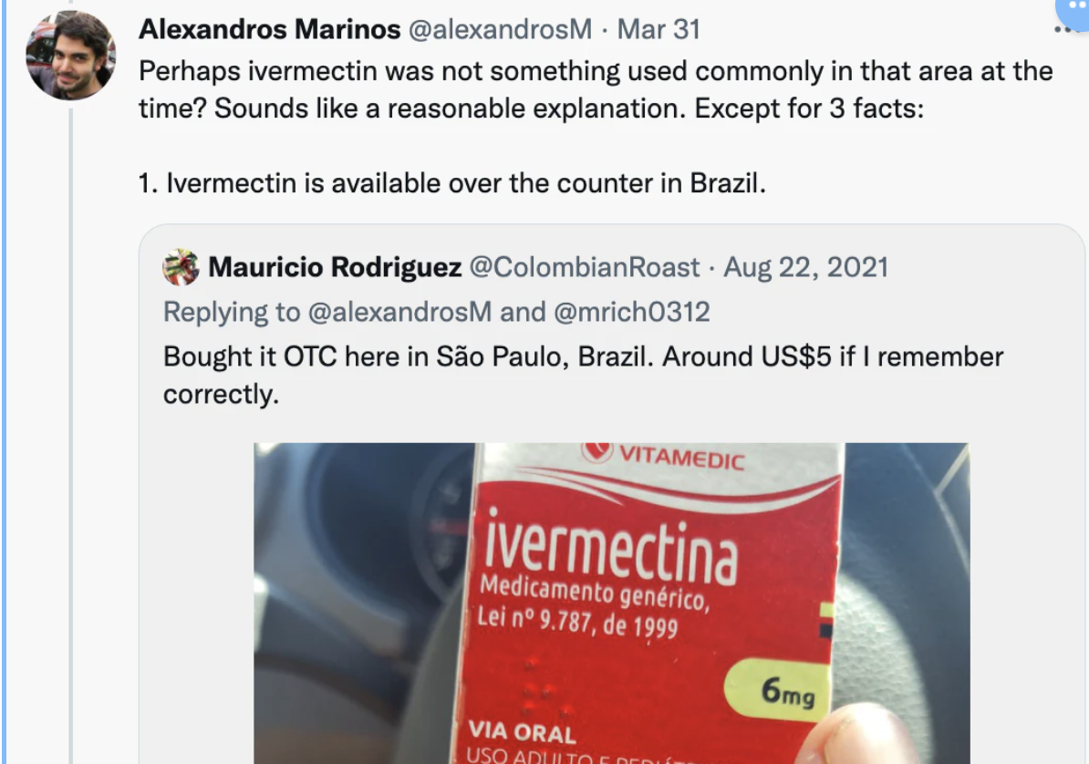
FATAL FLAW #1 – conducting the trial in an area where ivermectin use was rampant.. And not having use as an exclusion criteria???

Slide 15
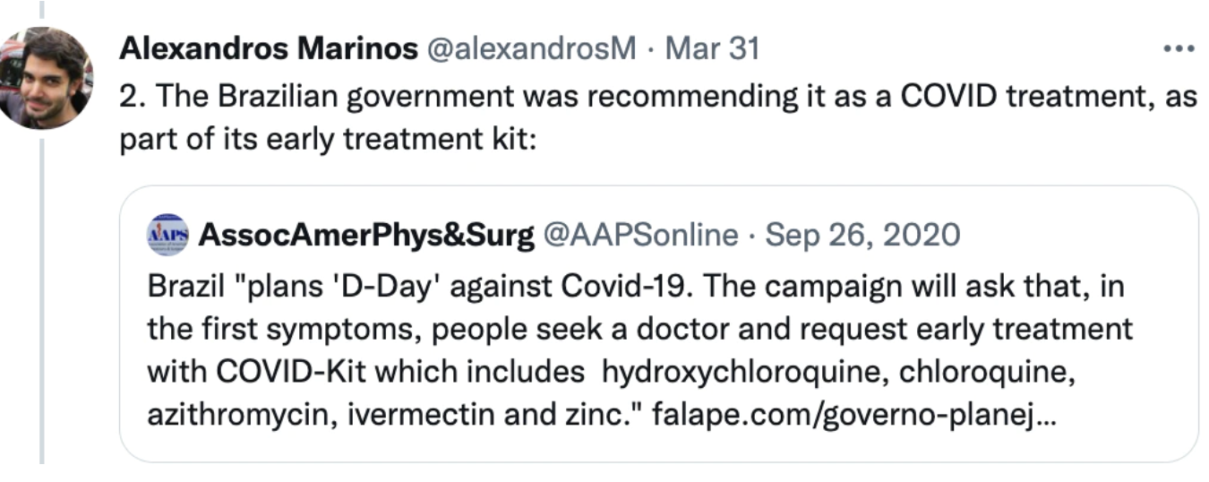
Brazil was promoting early treatment

Slide 16
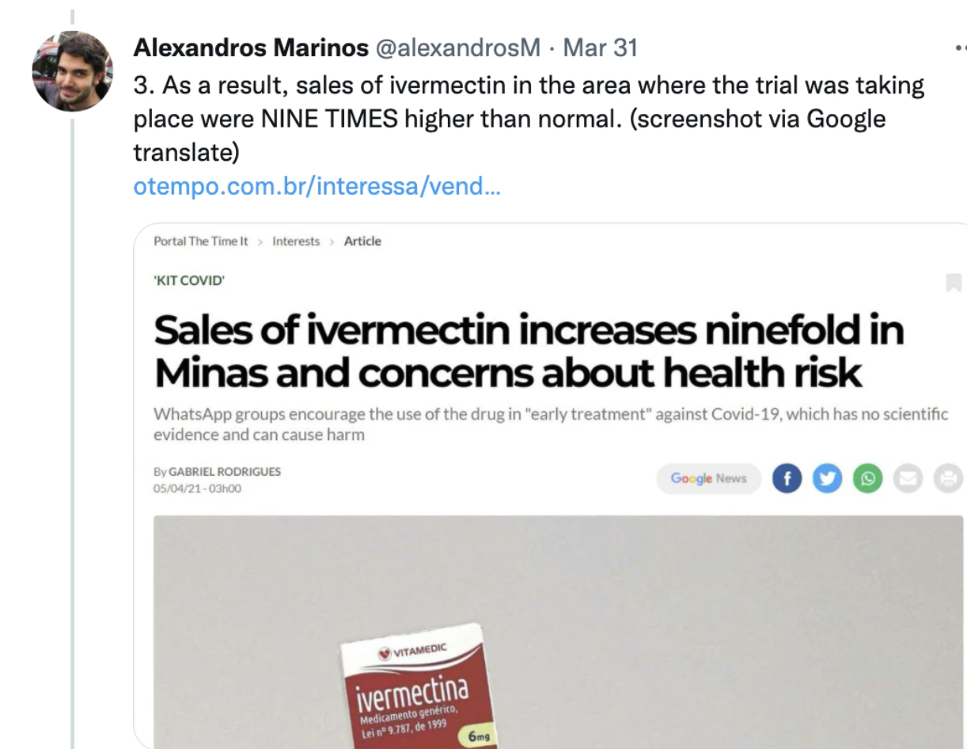
Sales of IVM were skyrocketing in the region
Principal Investigator:
At the time we did our study, IVM was not particularly popular
for use in Minais Gerais. Even if some patients did access IVM,
the fact that it is blinded should still maintain balance.

Slide 17
UNDERDOSING CONTROLS IN PHARMA TRIALS IS A KEY TACTIC IN HEAD TO HEAD TRIALS

Slide 18
FATAL FLAW #2 and #3.. DOSING And Duration
The started the trial with a single dose to be given at 0.2mg/kg. For, you know.. Parasites! They “used dosing similar to parasite dosing.” This is another tell – they know it is an anti-viral
Then they changed it to 0.4mg/kg for three days “after feedback from advocacy groups” – late night email to me, no context given, no knowledge of gamma. At the time of the trial, Brazil MD’s – way higher doses used (we soon changed to 0.4-0.6 for 5 days or until recovered)
But why only 3 days?
  Molnupiravir – an anti viral – 5 day dosing
  Paxlovid – an anti-viral – 5 day dosing
  Oseltemavir – 7 day dosing
  Lopinavir/ritonavir – 14 day dosing

Slide 19
More “Funny Business” with Dosing
Our “advocacy group” has recommended IVM to be taken on a full stomach
  In the TOGETHER trial.. they specified on an empty stomach
Further, they had a weight limit of 90kg at 0.4mg/kg =198 pounds
  Every patient over 198 pounds… thus got less than 0.4 KG
  50% of patients had BMI ≥30. Much greater efficacy was seen in the low BMI subgroup (RR 0.77 vs 0.98).
These 4 issues are CLEARLY an attempt for this trial to use the lowest dose possible that they could get away with to achieve a non-successful result
  attempting a one-day trial
  converting to 3 days only
  specifying an empty stomach,
  limiting 0.4mg/kg dose to 198 pound limit

Slide 20
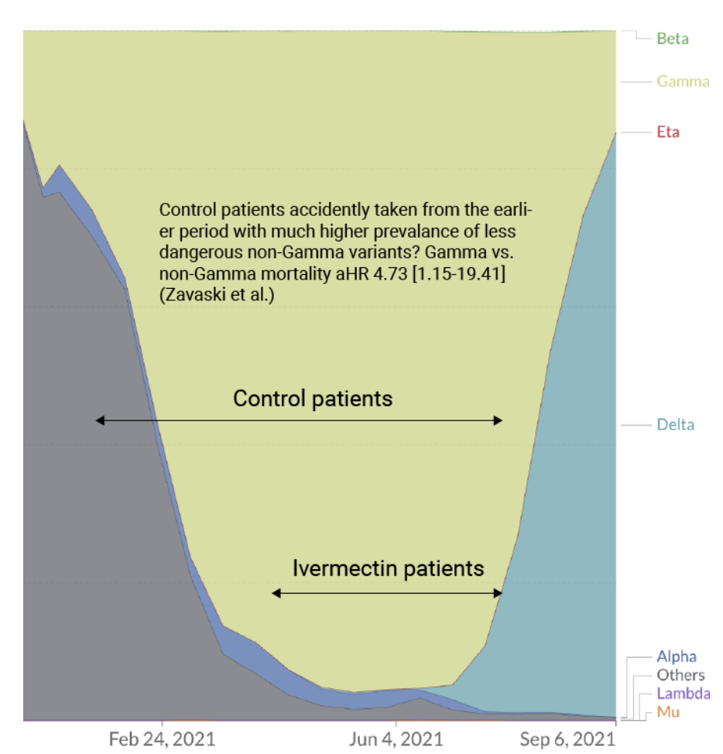
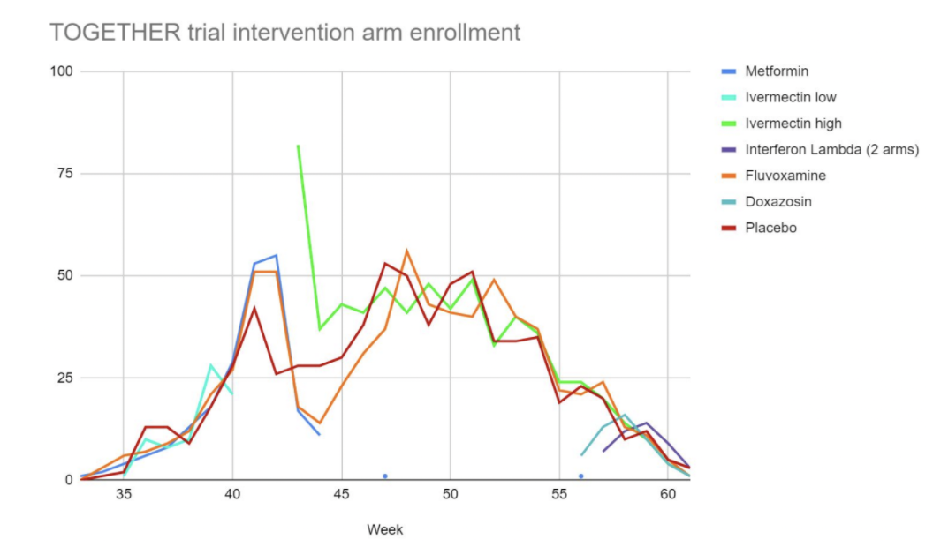
PLACEBO PATIENTS AND IVM PATIENTS WERE NOT ENROLLED AT THE SAME TIME - BUMMER
Control group patients were enrolled at earlier time points than the ivermectin patients, when far less deadly variants predominated

Slide 21
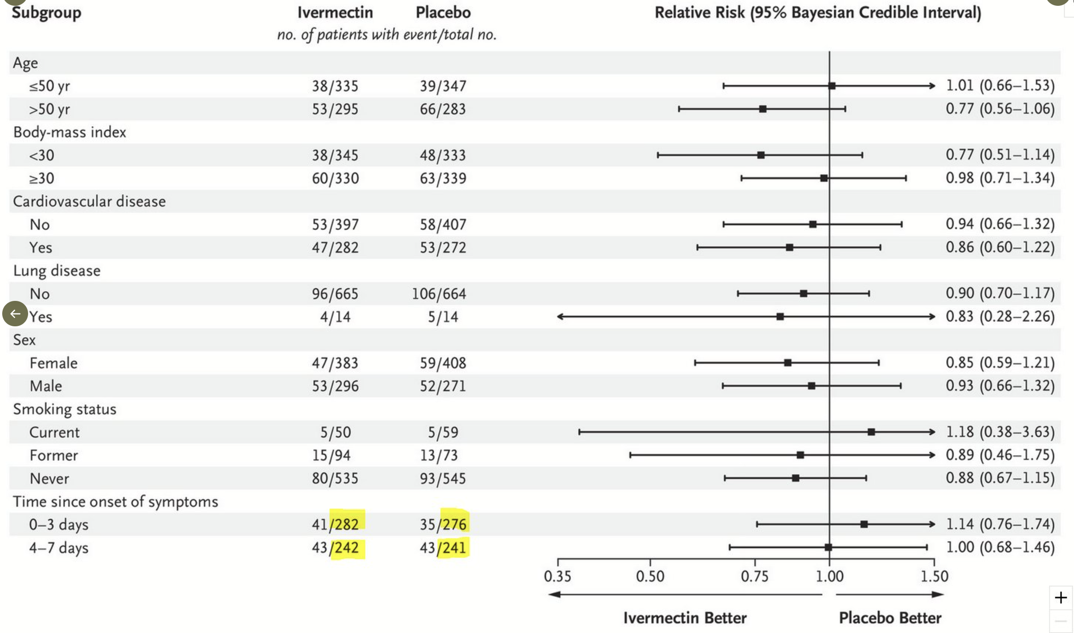
THE OVERPERFORMING MISSING DAY-OF-ONSET PATIENTS
Note that the total patients in the IVM and Placebo column should be 679
When you “reverse calculate”
the outcomes for patients with
“unknown days since onset,” you find they had a 50% reduction in the primary outcome if treated with ivermectin
542?
571?

Slide 22
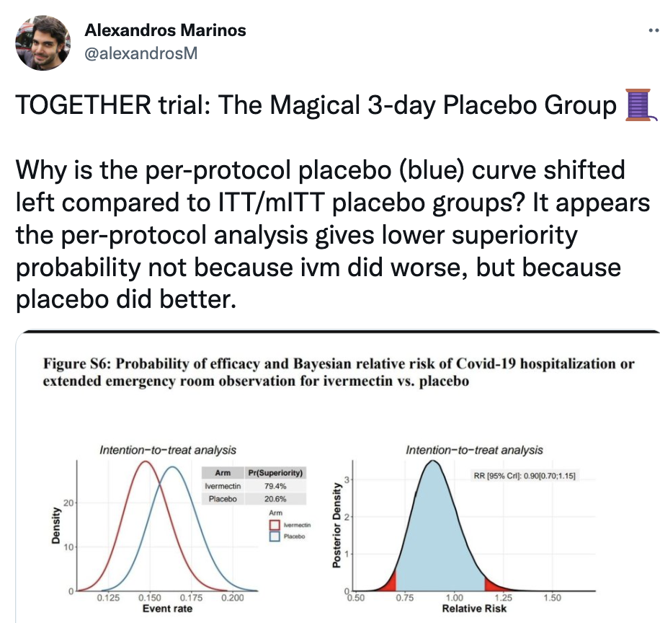
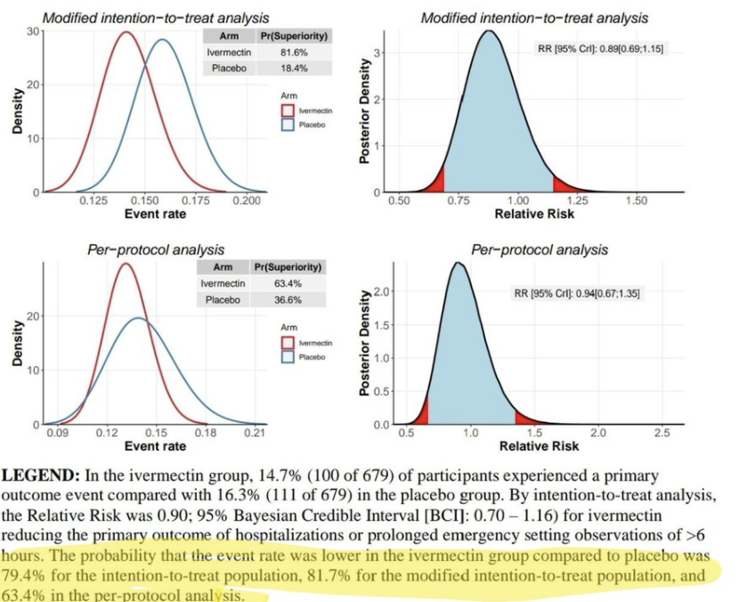
THE OVER PERFORMING
3-DAY PLACEBO GROUP?

Slide 23
Trial Completed 7 Months Ago.. Why did it take 7 months to publish with the entire world waiting?
An incredible delay given the importance of the result in guiding treatment
Large change in results from previously released data. The published results are very different from the previously released results, for example 100/679 vs. 86/677 for the primary outcome ivermectin events. The mortality RR changed from 0.82 to [0.88/0.81/0.80] for [Table 2/Table 2 AE/Table S6].

Slide 24
7 MONTHS LATER, “VERE IS ZE DATA”?
The trialists always stipulated they would make the dataset publicly available on request
  This is a MAJOR, KEY ISSUE with RCTs and Big Pharma – the lack of transparency has led to major shenanigans over decades (Pfizer vaccine trial anyone?)
Yet – they have not released the data to anyone, even their funders, since completion, despite repeated requests from many groups
Now they have changed how that data can be accessed – they are releasing it to a 3rd party and then researchers have to apply to that 3rd party

Slide 25
TOO MANY ISSUES REMAIN TO TALK ABOUT… HOW ABOUT JUST 3 MORE
Dr. Cadegiani:
  Brazil is the LARGEST SINGLE BUYER of drugs and vaccines in the world. The national health system has the ability to buy almost half trillion dollars per year. Contracts of dozens of billions of dollars are common. Many of them with Pfizer.
  Easy to conduct a trial in Brazil with corrupted CROs (I have proof of that) to allow these conclusions.
Anomalous results from the same region. A local Brazilian investigator reports that the study was conducted in almost the same time and location as the Brazilian component of the molnupiravir trial. Notably, molnupiravir's EUA relied on the unusually higher efficacy observed in Brazil.

Slide 26
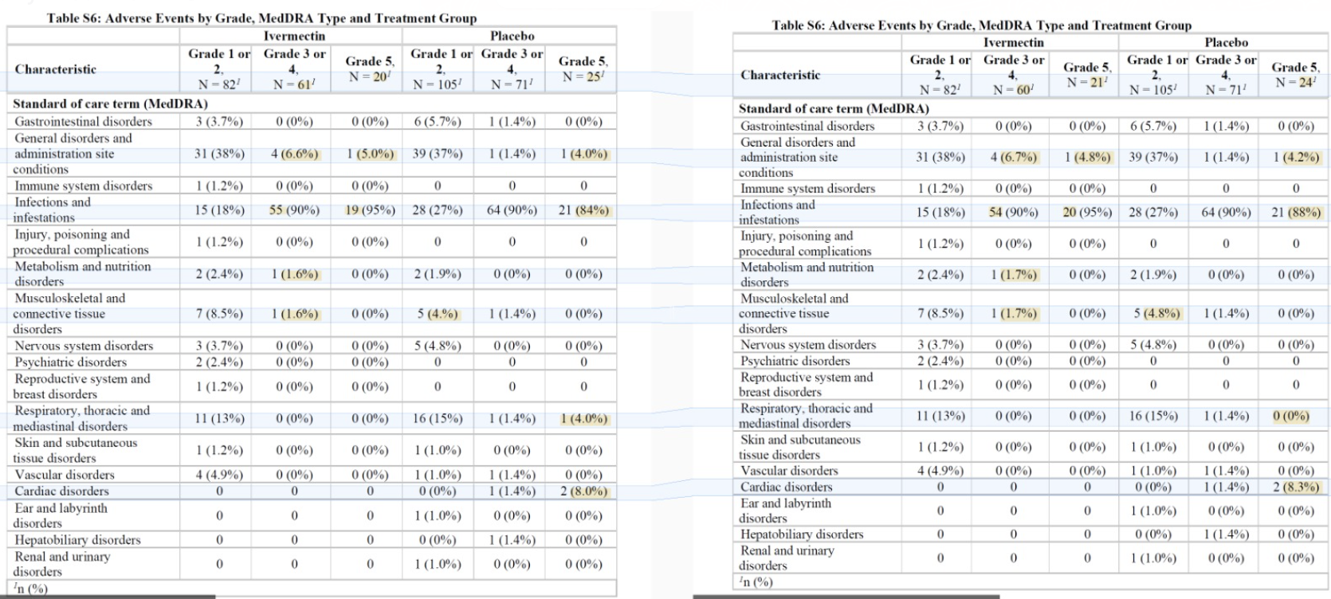
THIS JUST IN.. THEY CHANGED THE DATA YESTERDAY.. AFTER PUBLICATION??

Slide 27
CONFLICTED RESEARCHERS WITH “NOTHING TO HIDE” START TALKING FROM BOTH SIDES OF THEIR MOUTH
Ed Mills, Principal Investigator: Prior to trial, he has made multiple public and private (email) statements that those who recommend ivermectin are “advocates” and “he does not believe it works” (does not call us clinicians or researchers or... COVID experts)
IN HIS TOGETHER TRIAL PRESENTATION FROM 7 MONTHS AGO, MADE THESE COMMENTS:
“we got a lot of criticism for single day dosing” (Criticism? How about helpful guidance?)
“we found that it had no effect, WHATSOEVER, on our primary outcome”
86/677 (12.7%) vs 95/678 (14.0%) (No benefit? Oh, you mean “statistically significant?”
“we do not see the treatment benefit that a lot of advocates believe should have been seen”

Slide 28
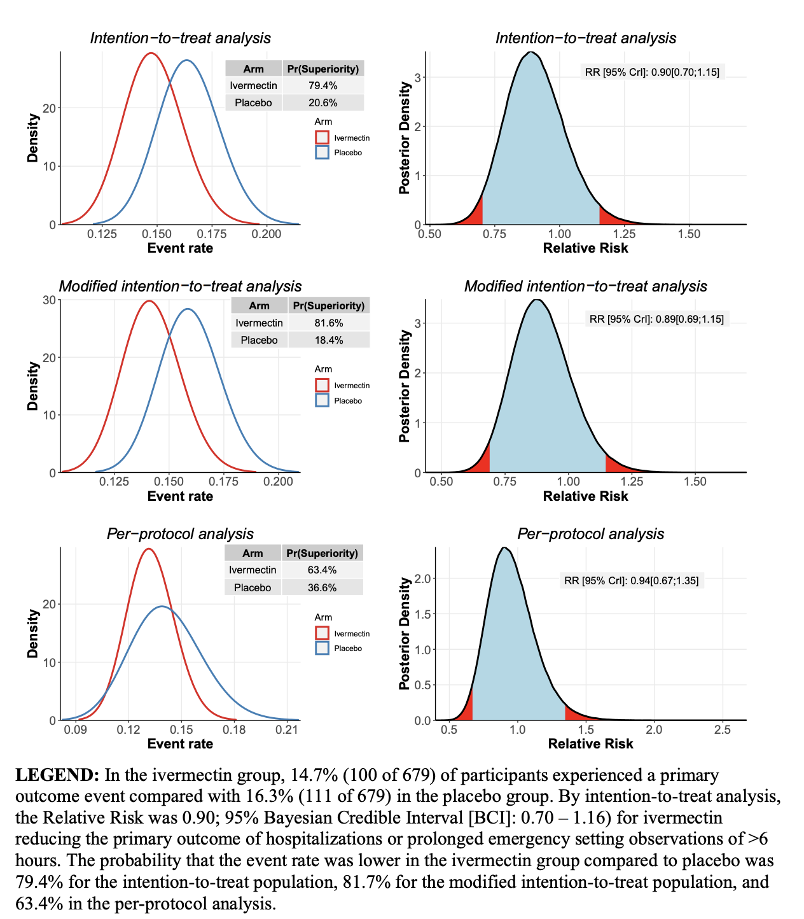
7 MONTHS LATER, DESPITE SHENANIGANS…BAYESIAN STATISTICS FINDS HIGH LIKELIHOOD OF SUPERIORITY

Slide 29

Words of the Principal Investigator when asked about this issue
for the Wall Street Journal 10 days ago:
“There was no indication that ivermectin is clinically useful”
What he says in his NIH presentation and now privately
(and what the data shows in the paper)
“I presented this a couple weeks ago at the NIH Collaboratory
Rounds and, if they listened, I advocate that actually, there is a
clear signal that IVM works in COVID patients, just that our study
didn’t achieve significance. In particular, there was a 17%
reduction in hospitalizations that would be significant if more
patients were added. I really don’t view our study as negative
and, also in that talk, you will hear me retract previous
statements where I had been previously negative. I think if we
had continued randomizing a few hundred more patients, it would have likely been significant.”

Slide 30

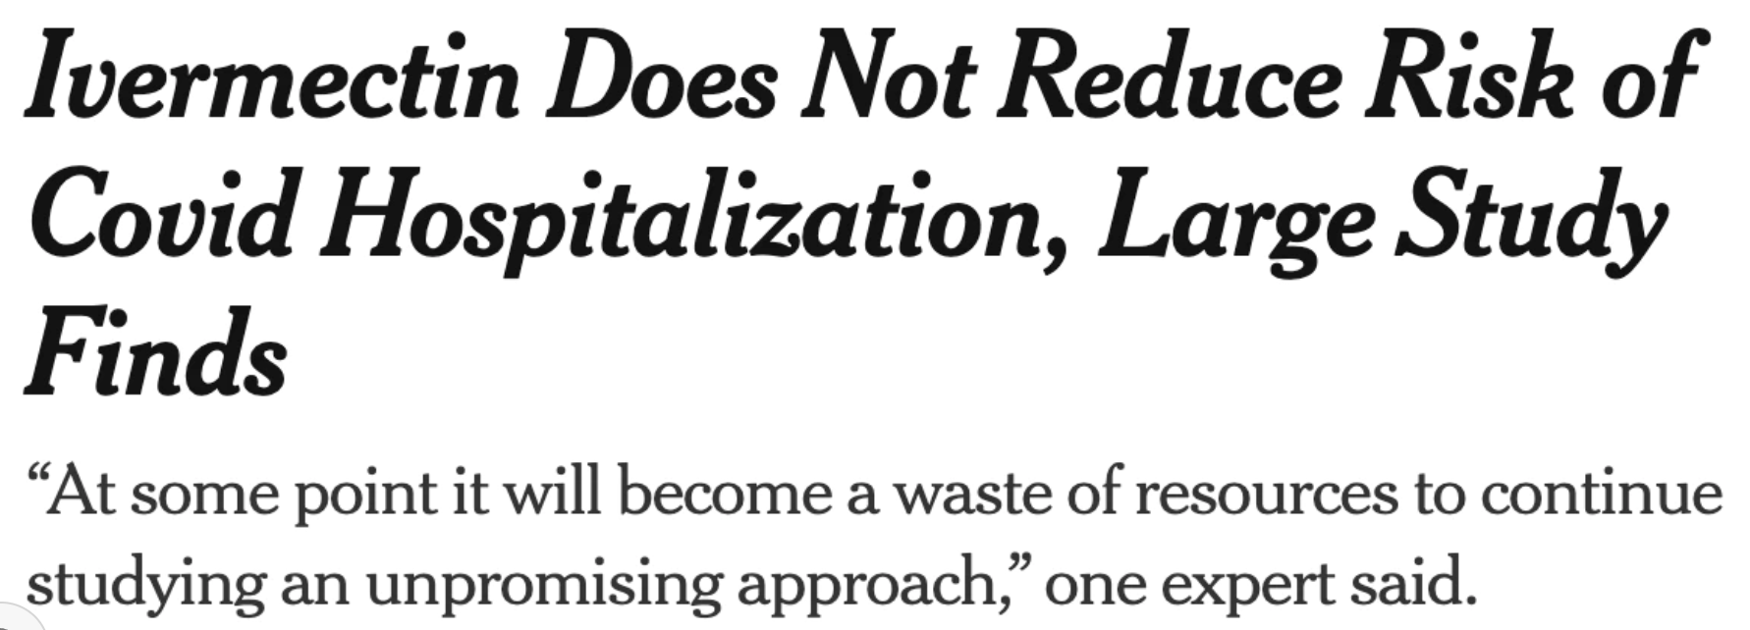
This week: “There’s really no sign of any benefit,” said Dr. David Boulware, an infectious-disease expert at the University of Minnesota
“Now that people can dive into the details and the data, hopefully that will steer the majority of doctors away from ivermectin towards other therapies,” Dr. Boulware said.

Slide 31
“On their second review, Dr. Hill and his colleagues focused on the studies least likely to be biased. In that stricter survey, ivermectin’s benefit vanished.
“Still, even the best studies on ivermectin and Covid were small, with a few hundred volunteers at most. Small studies can be vulnerable to statistical flukes that suggest positive effects where none actually exist. But larger studies on ivermectin were underway at the time, and those promised to be more rigorous.”

Slide 32
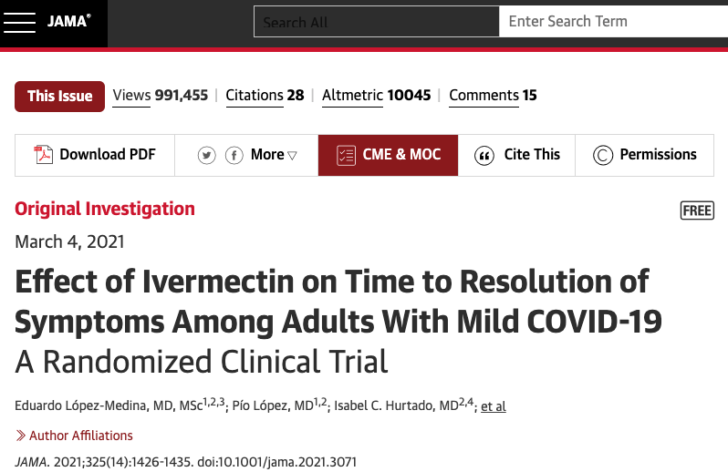
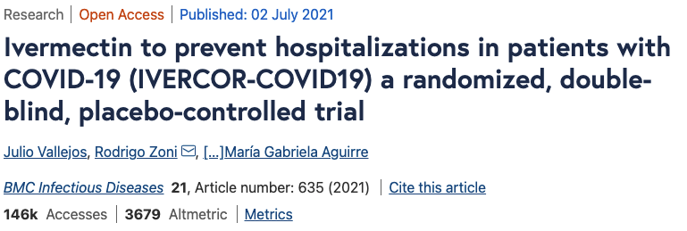
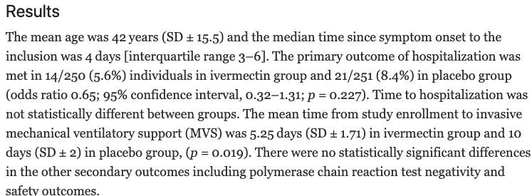
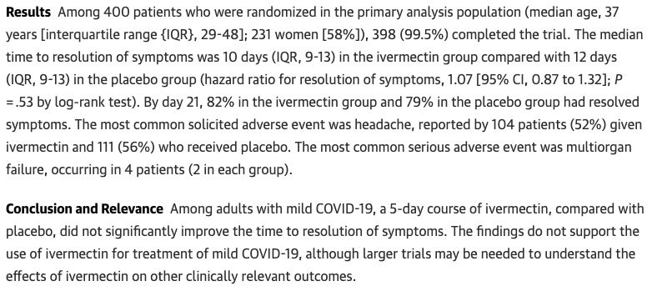
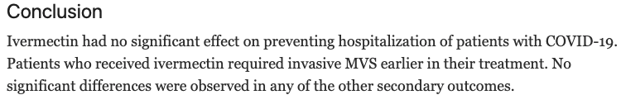

Slide 33
STEVE KIRSCH ASKED ED MILLS TO HAVE A PUBLIC DISCUSSION WITH ME
We suggested Bret Weinstein – “not impartial enough”
I suggested I would sit with him and whoever of his Ivory Tower friends he wants to discuss with
  “No-one wants to do it. Pierre generates a negative response”

Slide 34
Evidence Based Medicine Lie #2
“Results from studies with ‘high risks of bias’ cannot be trusted”
TENET OF MODERN PHARMA-CONTROLLED MEDICAL JOURNALS
  “Low Quality,” “Small,” “Observational Trials” with “high risk of bias” are not evidence of efficacy”… and are not sufficiently robust to be published
Harvey Risch, PhD:
  Risks of bias, even if accurate, are not evidence of bias, nor estimates of actual bias.
  Risks are subjective and scored according to epidemiologically irrational ad hoc principles.
  Their adjustment does not generally alter results (Hartling et al., 2013; Bae, 2016)
  They introduce random information that makes the observed adjusted results even more imprecise.

